Slide 1
Burial Wrapping
The following is one example of how to wrap a body for burial.

Slide 2
Materials Needed
Fabric type
Fabric cuts
Pins or strips of fabric to secure wrapped fabric in place

Slide 3
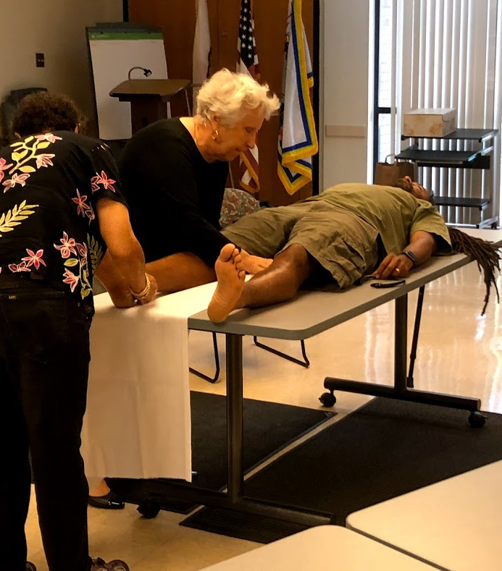
Wrap each leg.

Slide 4
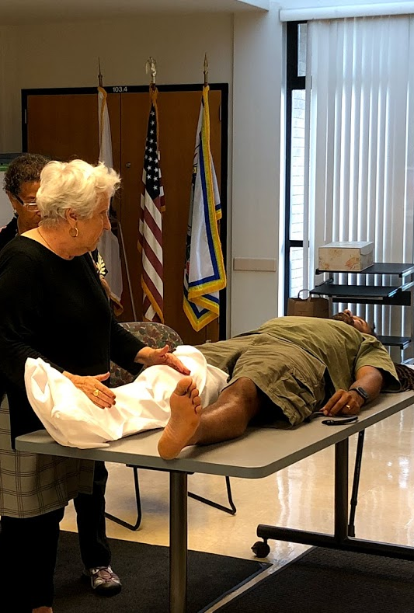
Use pins or fabric strips to hold the fabric in place.

Slide 5
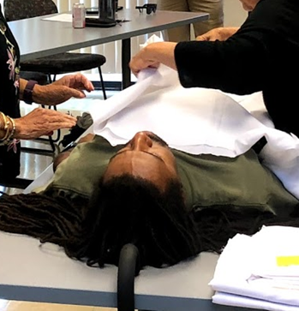
Wrap the torso of the body.

Slide 6
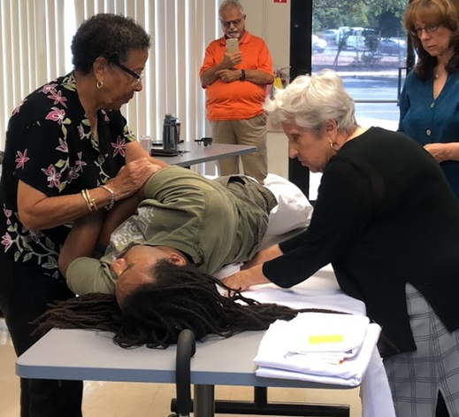
Tip:
Bunch half of the fabric and roll the body to the side. Place the bunched fabric under the center of the body.
Lay the body flat and roll from other side, pulling the bunched fabric from underneath the back.

Slide 7
Wrap one arm in the remaining torso fabric
Use a second piece of fabric to wrap the other arm.

Slide 8
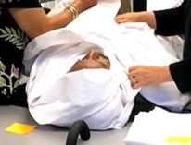
Wrap the head.

Slide 9
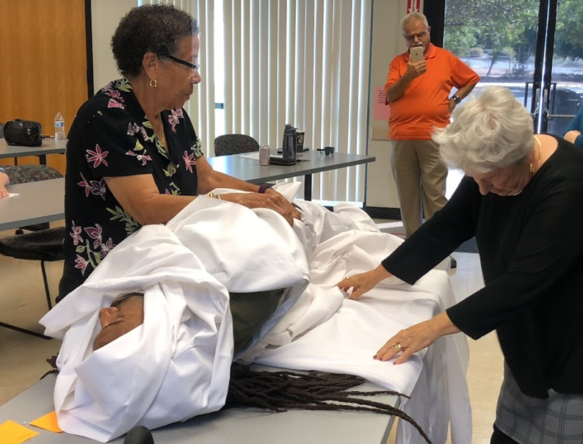
Prepare the body for the final wrap using the same methodology as when wrapping the torso: bunching half of the fabric and rolling the body to the side.

Slide 10
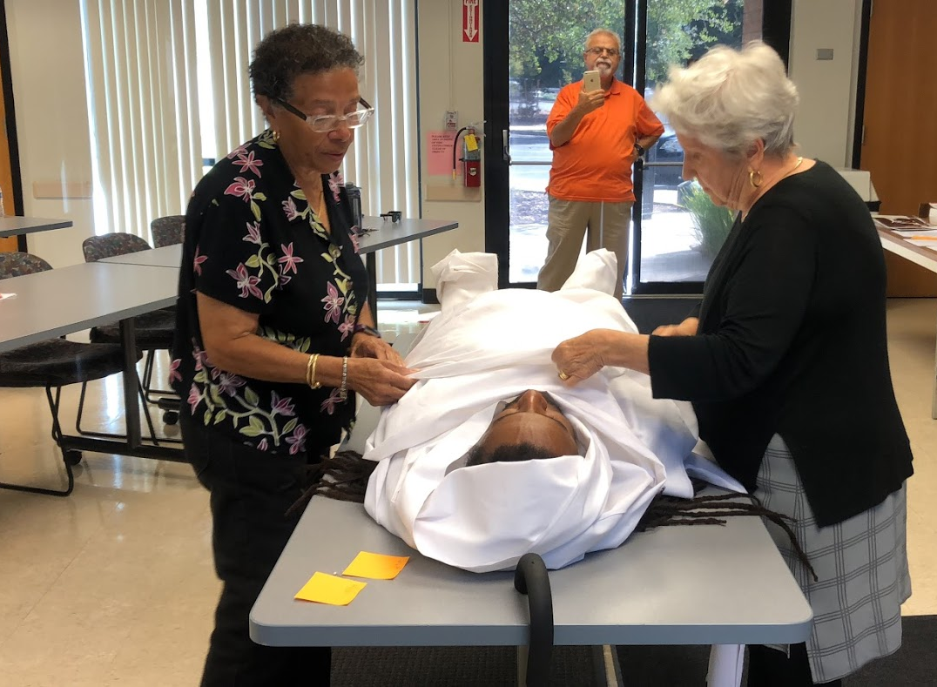
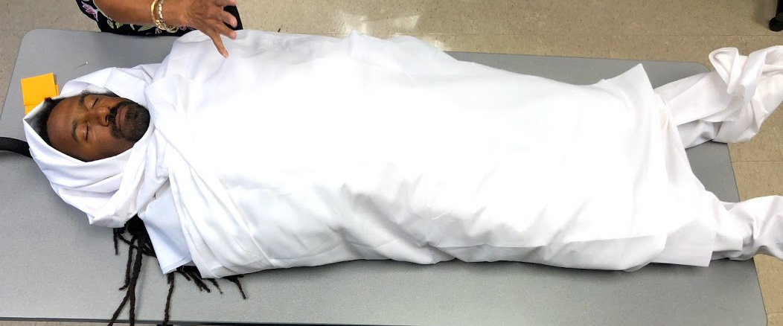
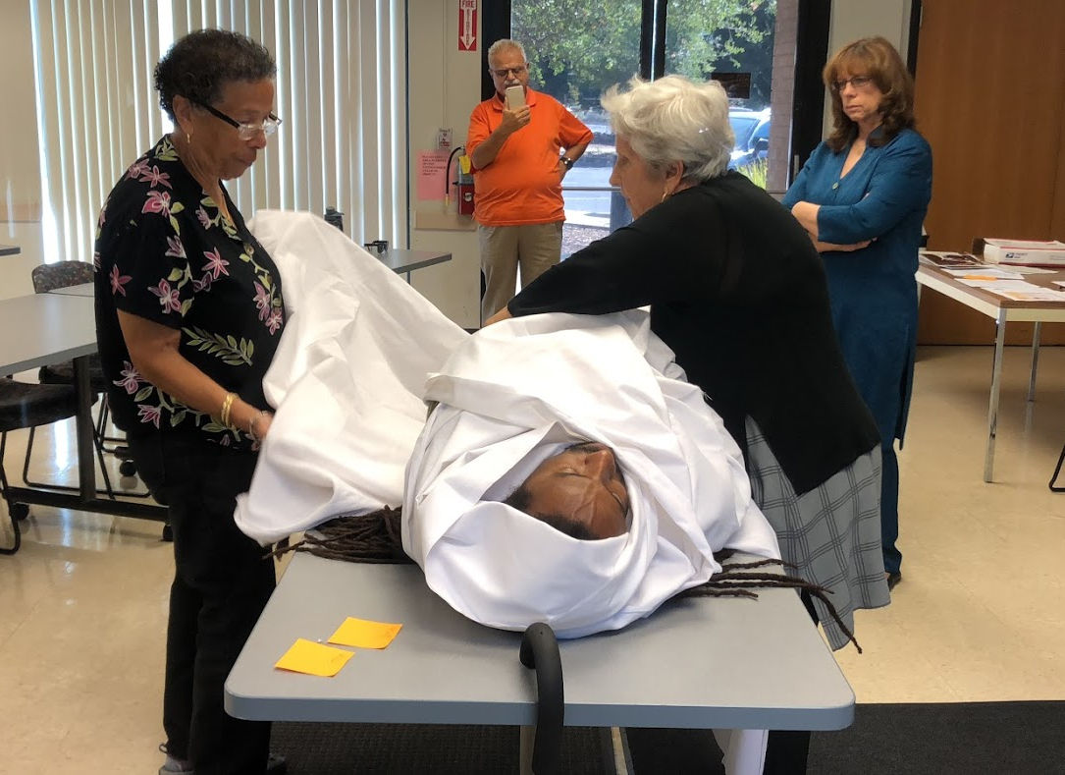
Pin the fabric in place or tie it in place with strips of fabric.

